Slide 1

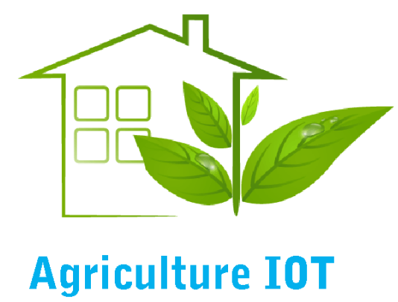
Presented by: V.kanmani S.Abarna II-CSE

Slide 2
INTERNET OF THINGS
The Internet of Things (IoT) is the network of physical objects—devices, vehicles, buildings and other items—embedded with electronics, software, sensors, and network connectivity that enables these objects to collect and exchange data.
Internet of Things = “Sensors and software are embedded in physical objects are linked through wired and wireless networks”

Slide 3
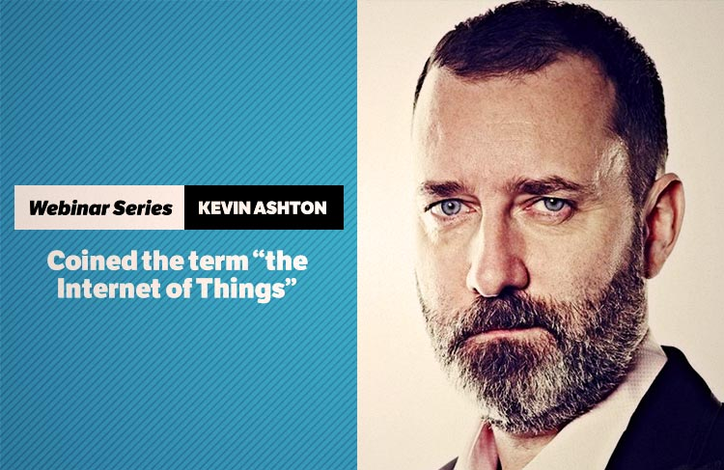
BIRTH OF IoT
KEVIN ASHTON, inventor of the internet of things.
The idea was often called “embedded internet”.
The actual term internet of things was coined by the year 1999 during his work at Procter and gamble.
He wanted to attract his senior manager’s attention to a new existing technology called RFID, Because internet was the hottest new tend in 1999.
He grabbed the interest of some P&G executives, but it does not widespread for the next 10 years.

Slide 4
RESEARCH
Year 2000 – Globally, there were 525 million farms on record, out of which not a single farm was connected to the Internet of Things.
Year 2025 – With same base of 525 million farms, there will be 600 million sensors in use at these farms – representing a major shift towards technological advancements being applied to agriculture to support the Agricultural Internet of Things.
Year 2035 – With 525 million farms globally, there will be a more than threefold growth in sensor usage compared to the year 2020. By 2050, there will be two billion sensors used in 525 million farms.

Slide 5
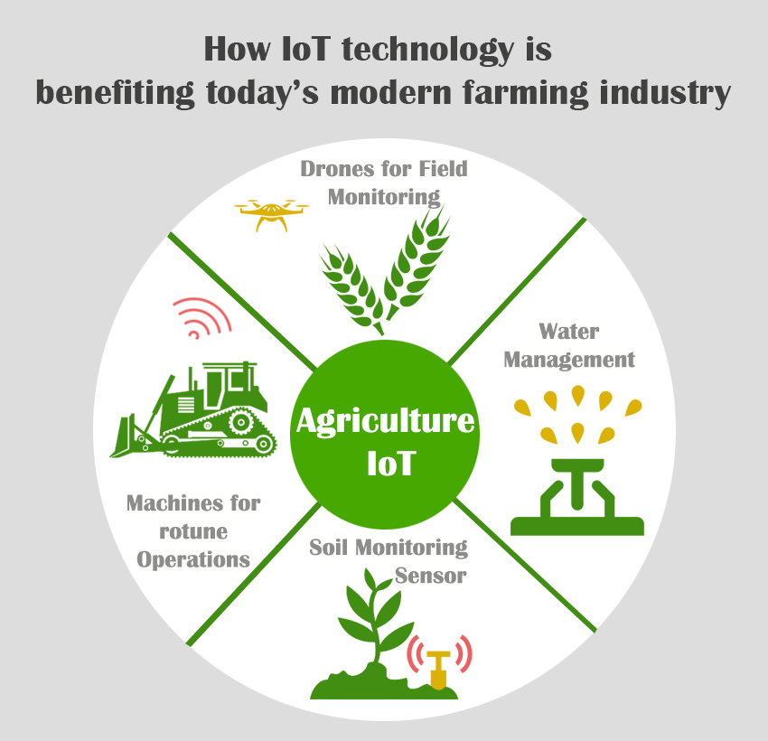
IoT IN AGRICULTURE
IoT farmers enable to contend with the enormous challenges they face. The agriculture industry must overcome increasing water shortages, difficult to manage costs, limited availability of lands, while meeting the increasing consumption needs of a global population that is expected to grow by 70% by 2050. (Reference: Food and Agriculture Organization of the United Nations).

Slide 6
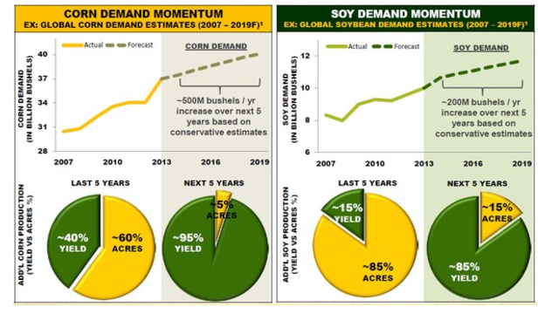
The advent of IoT into agriculture has been made into good times because the world population is expected to grow to 9.6 billion by 2020.
It would have been impossible to feed all those people when there are limited farming methods.
In order to keep up with the food requirements, it is imperative that a new and innovation method of farming should be introduced.

Slide 7
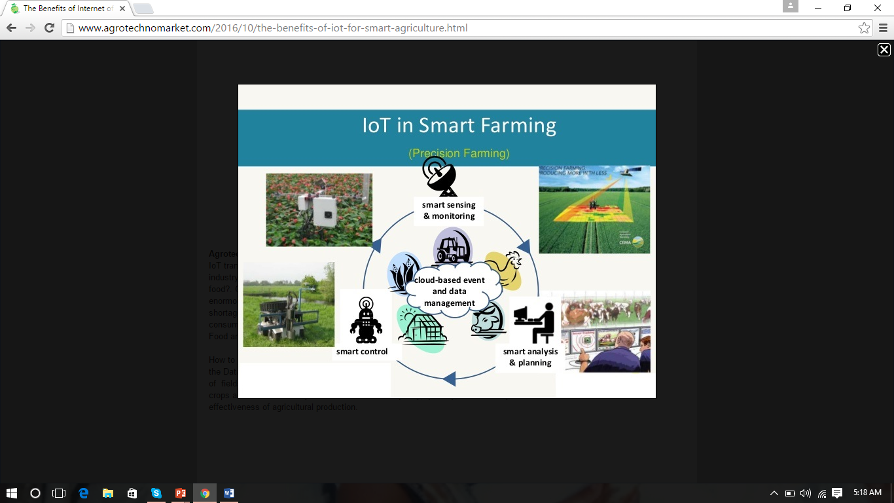
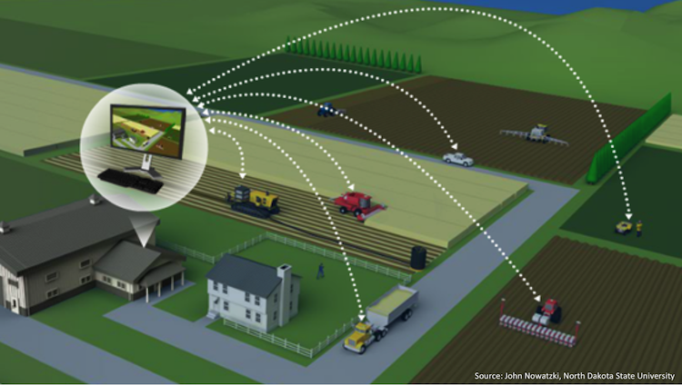
It can be helped by using the data. With the Data that the farmers get from new innovative IoT applications can be addressed the issues of fields, water, air and even the livestock. The IoT helps farmers better informed of their land, crops and animals so they know how to increase quality, quantity, sustainability and cost effectiveness of agricultural production.

Slide 8
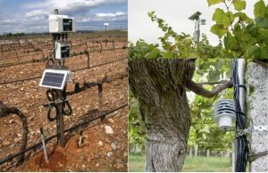
IoT DEVICES
Electronic agricultural devices
Product quality, higher crop productivity, resource conservation and cost control – these are just a few of the ways the Agricultural Internet of Things promises to transform farming and food production in the future. It helps increase crop productivity by managing and controlling such activities in the following ways:

Slide 9
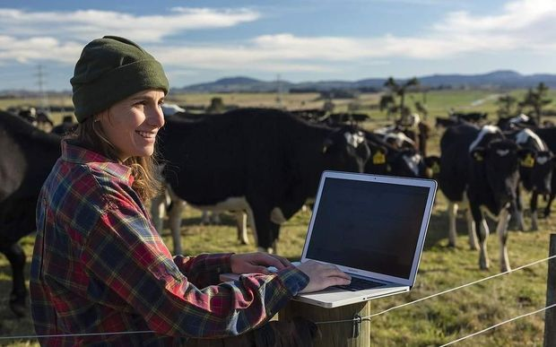
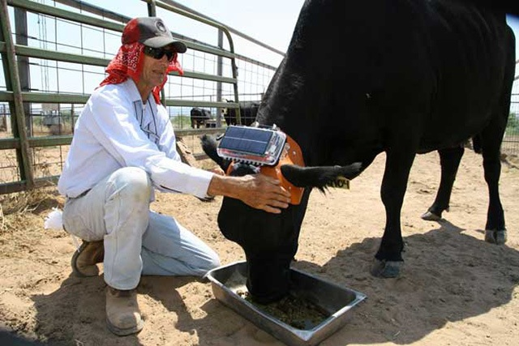
EXAMPLE FOR IoT USAGE
The team behind the Cow Tracking Project attach a GPS device to each cow, and placed sensors around their shed to monitor their movements and sleeping habits. The information was then sent to the farmer’s computer. Disruptions in a cow’s regular pattern (e.g. sleeping more or moving around less than usual) could signal illness Daily updates can help the farmer quickly catch these changes.

Slide 10
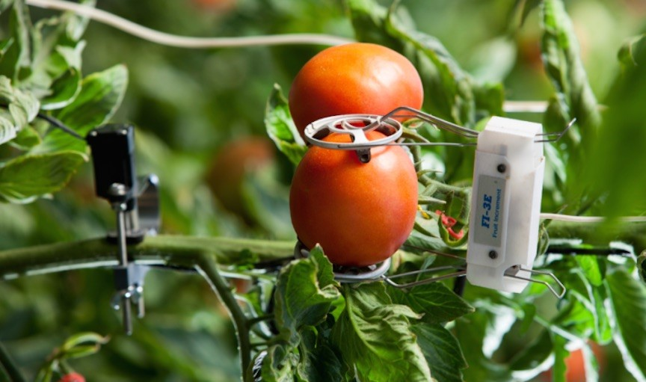
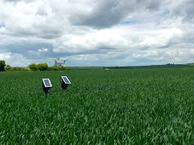
Food production and safety
Along with attaining optimum, quality food production, the Agricultural IoT aims to ensure food safety at different levels, like storage, transportation, etc. To do so, it has a monitoring system over various factors like shipping time, storage temperature, and cloud-based record keeping.
Livestock management
Supporting livestock health fortified with monitoring tools like as ear tags for cattle, capable of detecting respiratory diseases. If a disease is detected, it sends an alert so the animal can be separated from the herd, preventing the disease from spreading.

Slide 11
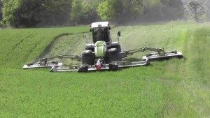
Examples of new applications
CLAAS Equipment – CLAAS is a leading manufacturer of agricultural machinery founded in 1913. The CLAAS Agriculture Internet of Things equipment can be operated on autopilot and farmers can receive advice on ways to improve crop productivity and reduce grain losses.
It collects important pieces of information for further analysis. This information may be used in field mapping and in various planning programs like fertilization and nutrient planning.

Slide 12
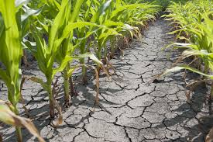
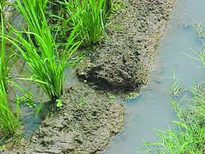
CROP WATER MANAGEMENT
Usually the farmer pumps the water more or less to cultivate the land.
This may result in wastage of water or insufficiency to the crops.
sends an alerting message to the farmer when the moisture level increases or decreases.

Slide 13
PEST MANAGEMENT
Often farmers hardwork are destroyed by
predators(pests) that results in huge loss to farmers.
To prevent such situation AGRICULTURE INTERNET
OF THINGS has a system that detects the motion
of predators using PIR sensors.
This information can be used by the farmers to reduce
damage done by predators.

Slide 14
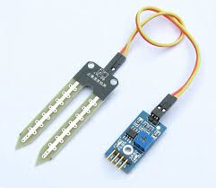
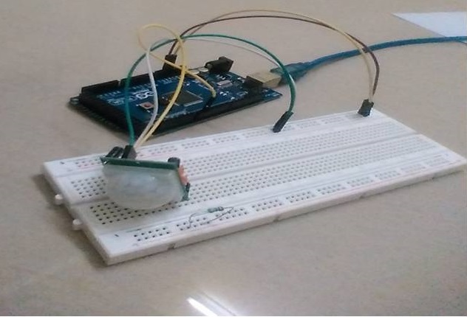
SOIL MOISTURE AND PIR SENSOR
A sensor that will sense
the moisture level in the
land (sand) called SOIL
MOISTURE SENSOR.
A PIR based motion
detector is used to sense
movement of people,
animals or other objects.

Slide 15
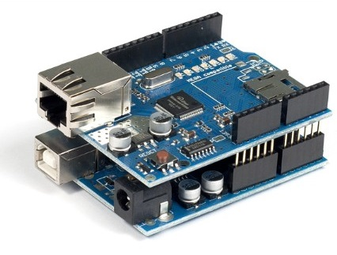
ARDUINO
Both SOIL MOISTURE SENSOR and PIR SENSOR are connected to the Arduino to perform an action.
Arduino will send the data
to the data base using
Ethernet shield and if
emergency it also send message to the user by using a device called GSM module

Slide 16
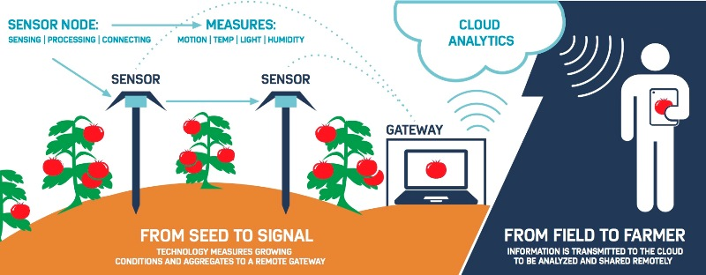
SMART SENSORS IoT RED AND RIPE
At the heart of the Internet of Tomatoes Project is a sensor-based system to measure the quality of the popular red produce. Source: ADI.

Slide 17
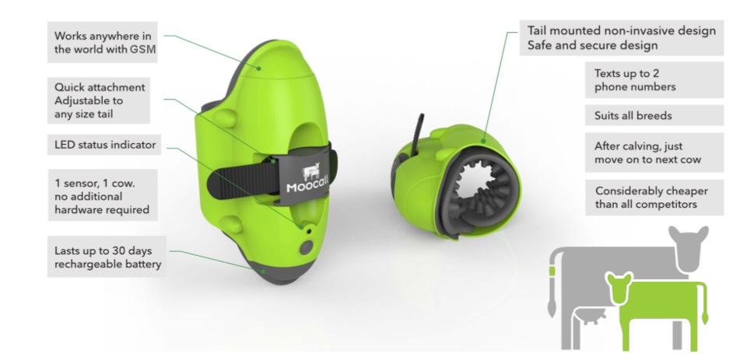
SMART SENSOR HERD MATERNITY

Slide 18
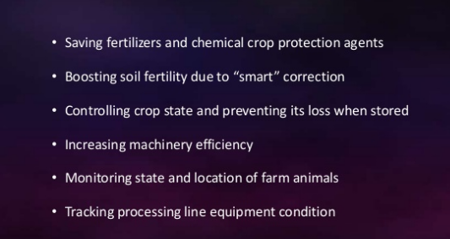
ADVANTAGES

Slide 19
DISADAVNTAGES
However advantageous the movement is, it comes with disadvantages as well.
Smart farming requires skills in robot and computer based intelligence, skills the average farmer would not necessarily have.
This would be the great challenge between farmers and information technology professionals to communicate to each other.
Finally, farming is a low margin industry so the willingness to invest in innovation is low as well.

Slide 20
CONCLUSION
The report Alternative Agriculture emphasized the importance of a systems approach to agricultural research 20 years ago, yet the proportion of long-term systems agricultural research remains small.
” To pursue systemic changes in farming systems, R&D has to address multiple dimensions of sustainability (productivity, and environmental, economic, and social sustainability) and to explore agroecosystems properties, such as complex cropping rotations, integrated crop and livestock production, and enhanced reliance on ecological processes to manage pests, weeds, and diseases (recognizing their interconnectedness and interactions with the environment), that could make systems robust and resilient over time.

Slide 21
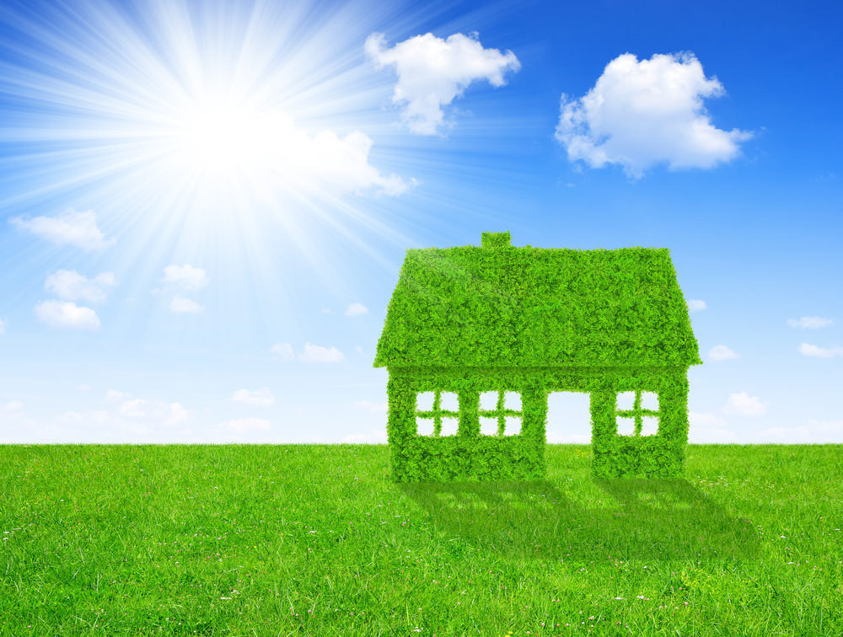
THANK YOU

